Slide 1
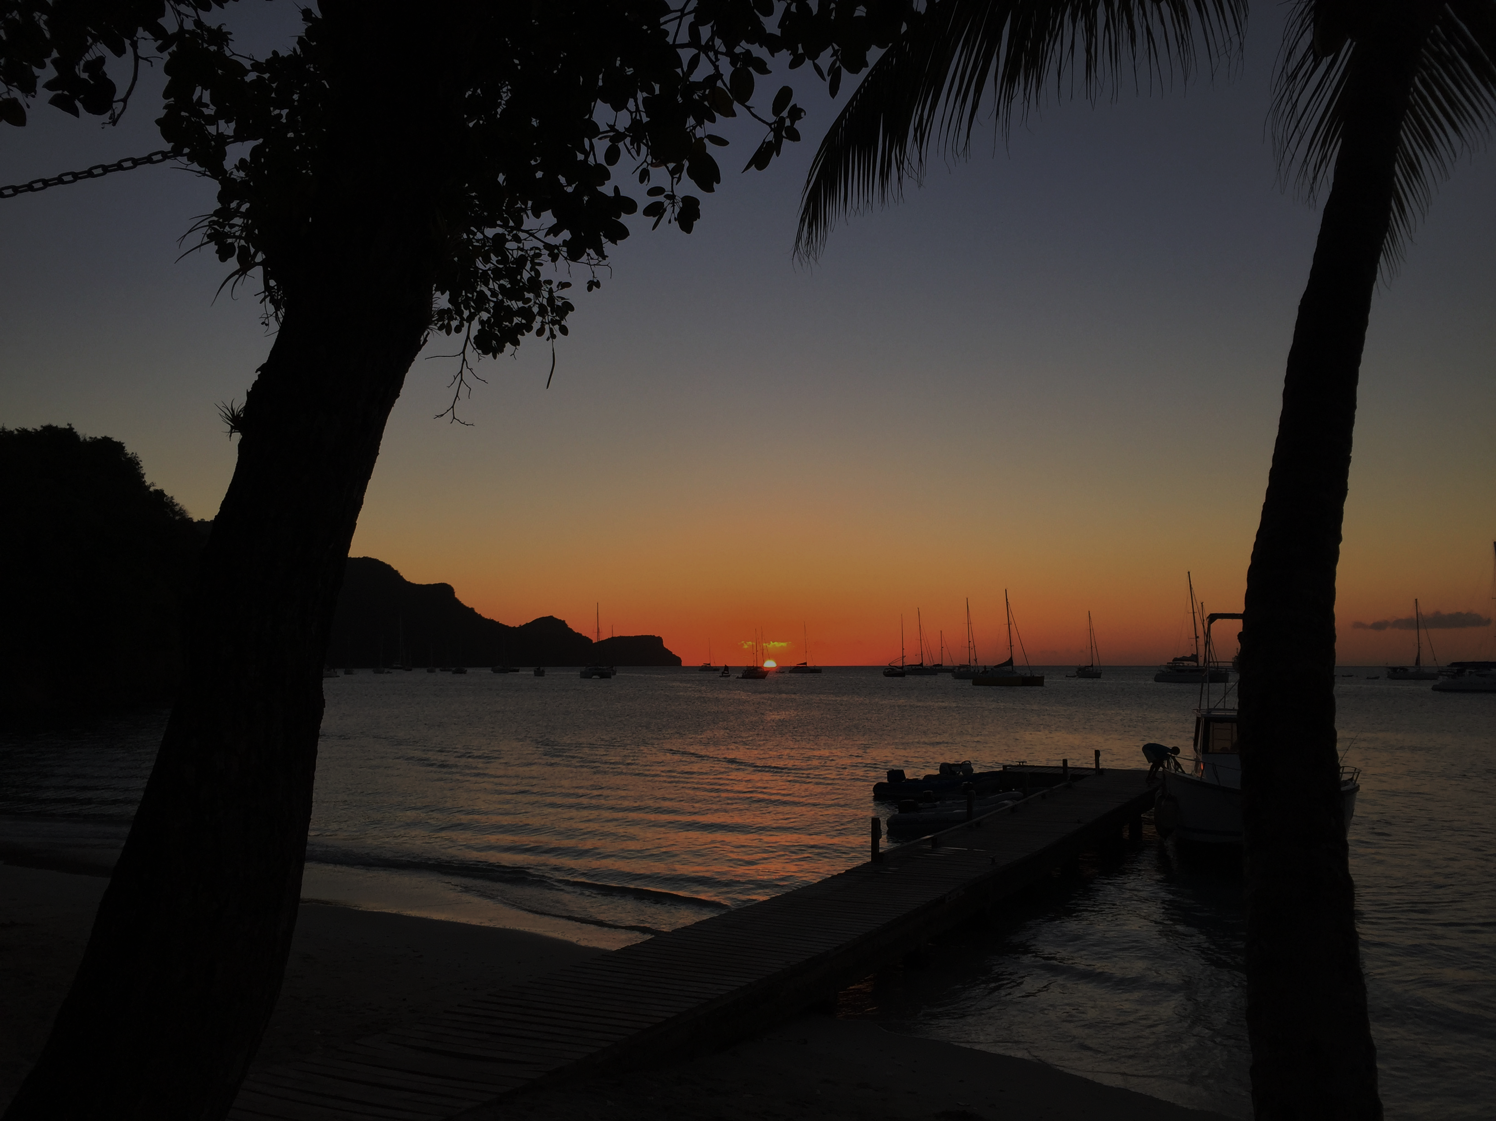
WEDDING PACKAGES

Slide 2
Thinking about getting married, renewing your vows or spending your honeymoon on the beautiful island of Bequia? You will not find a more perfect place in the Caribbean! Plantation Hotel is the ideal spot to create unforgettable memories for your special occasion
With its prime beach front location, secluded at the southern end of Admiralty Bay, Plantation Hotel has one of the most breath-taking views on the island. Looking out across the sparkling blue waters of the shimmering Caribbean Sea, a golden sun tosses her rays into the evening sky. The atmosphere is filled with the scent of blooming flowers, and coconut trees nestled amidst acres of mature land.

Slide 3
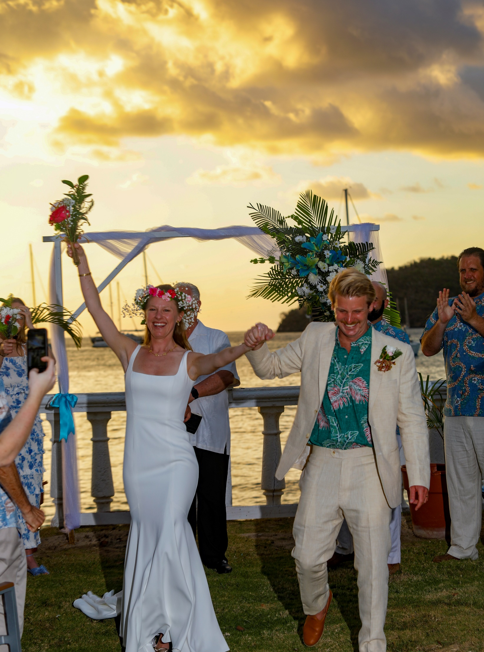
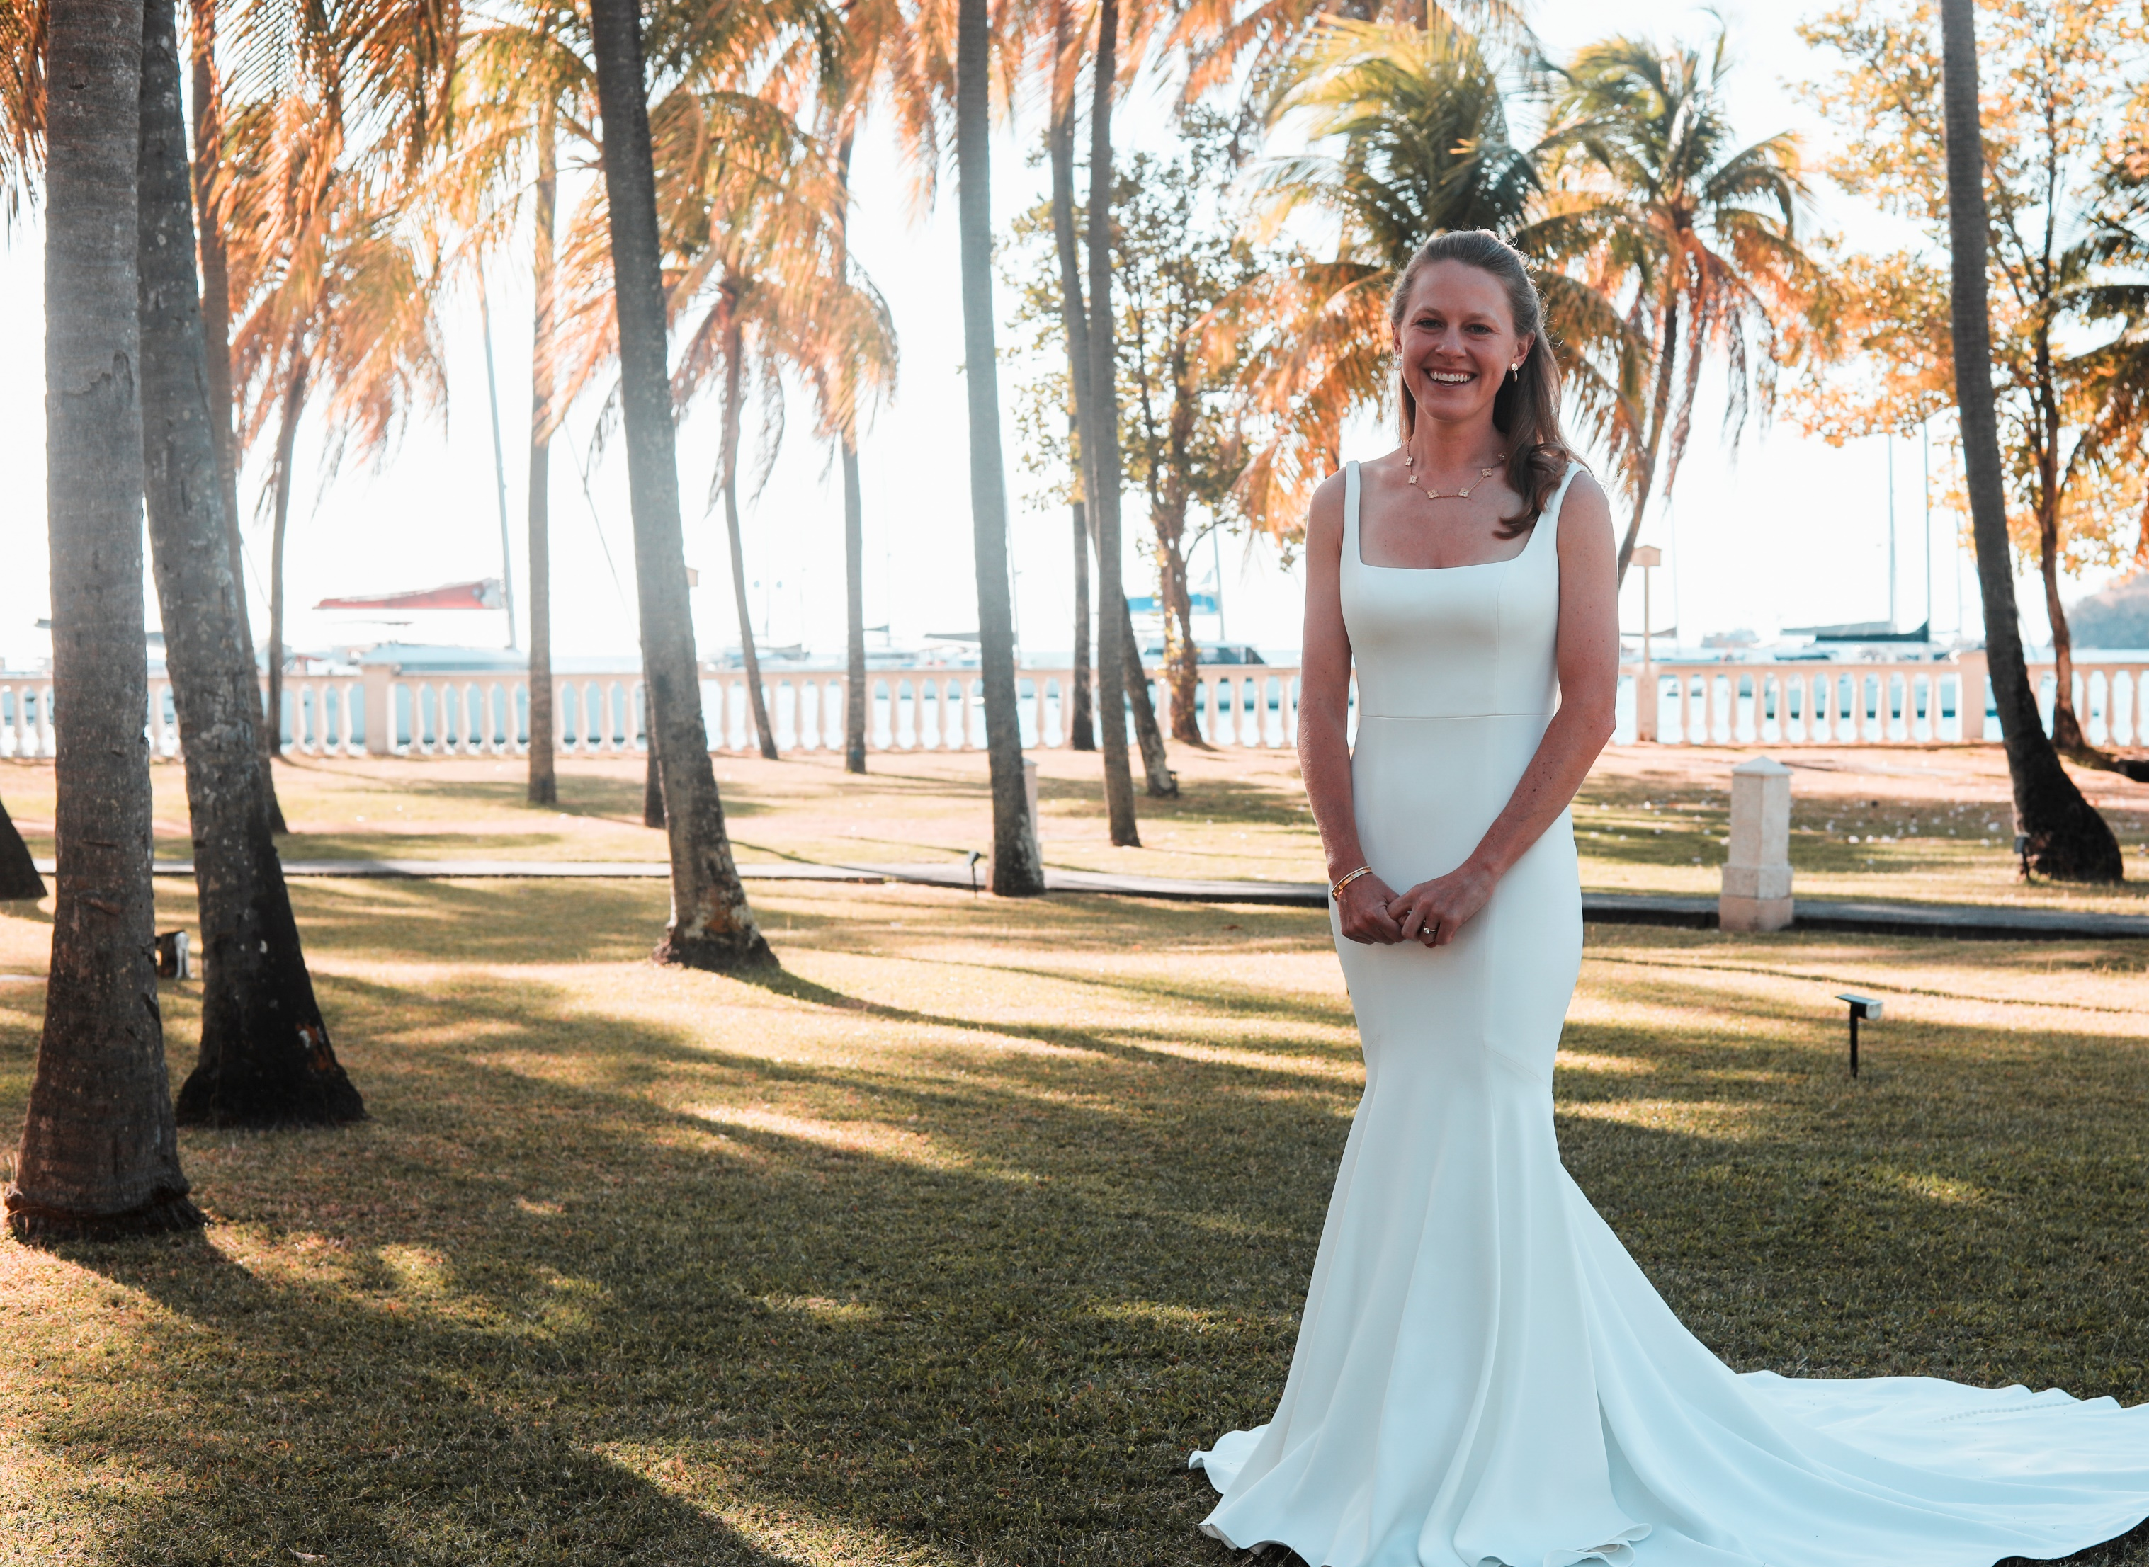
WEDDING PACKAGES
Our Wedding Packages offer you the starting point to create
your perfect day.
We will be delighted to discuss all aspects of your wedding with you
and tailor it to your requirements

Slide 4
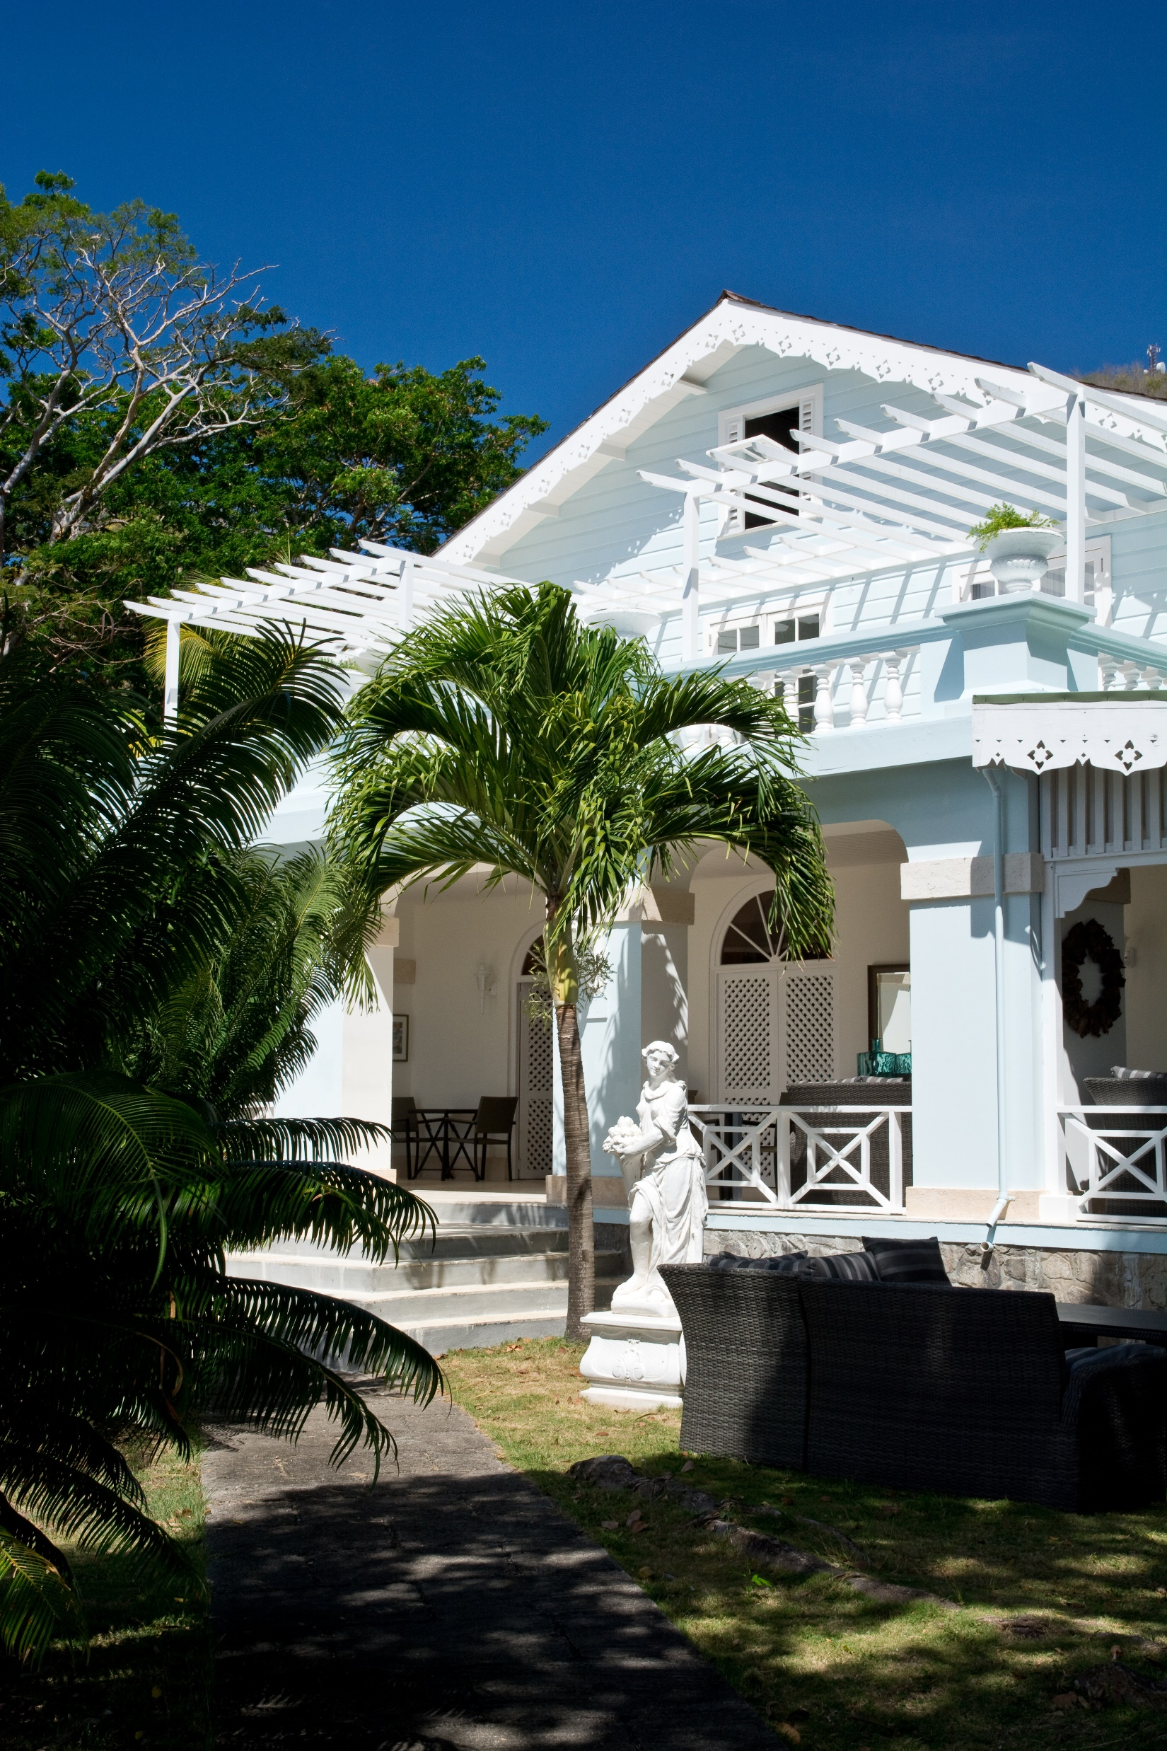
IVORY ELEGANCE
US$ 1450.00
Champagne and Tropical Platter on arrival for the bride and groom
Bouquet of fresh, local flowers for the bride
Table and beach ceremony decorations for up to 10 guests
Boutonniere for the groom
Wedding cake (one tier)
One Bottle of champagne for the wedding ceremony
Complimentary Airport/Ferry port transfer
CARIBBEAN BLISS
US$ 1700.00
Champagne and Tropical Platter on arrival for the bride and groom
Bouquet of fresh, local flowers for the bride
Table and beach ceremony decorations for up to 10 guests
Boutonniere for the groom
Wedding cake (two tier)
One Bottle of champagne for the wedding ceremony
In-room Champagne Breakfast on the morning of the wedding
Bridal Manicure
Complimentary Airport/Ferry port transfer

Slide 5
PARTY FOR UP TO 10 RESIDENTS
You can be married on the beach with drinks and intimate
wedding meal in our beach front restaurant.
Wedding Accommodation
We are delighted to offer 10% discount on our best available rate for all wedding guests.
PARTY OF MORE THAN 10 RESIDENTS
Bequia Plantation Hotel is required to be taken on exclusive use basis for
these numbers. This will ensure complete privacy and give you and your
guests’ uninterrupted access to the grounds throughout your stay, perfect
for photographs against the backdrop of the lush gardens and ocean.
Exclusive Use Only
10 April 2022 – 15th 2022 December
$US 9,500 per night
16th December 2022 – 9th April 2023
$US 11,000 per night
The exclusive use rate is based on overnight accommodation in
24 bedrooms and villas for up to 64 guests on a bed and breakfast
basis, all public rooms and hotel grounds. The exclusive use
charge does not include food and drink, this is extra.
OPULENCE
US$ 2000.00
Champagne and Tropical Platter on arrival for the bride and groom
Bouquet of fresh, local flowers for the bride
Table and beach ceremony decorations for up to 10 guests
Boutonniere for the groom
Wedding cake (two tiers)
One Bottle of Champagne for the wedding ceremony
Romantic private dinner for 2 on the per-wedding night
Champagne breakfast in room morning
after the wedding for the Bride and Groom
Couples massage on a day of your choice
Complimentary Airport/Ferry port transfer
Additional Services
Our team member will be able to recommend a photographer and florist,
we can also arrange musicians including traditional Steel Pans. If should
you require any of these services, we are happy to arrange this for you.

Slide 6
CEREMONY
A marriage ceremony at Plantation Hotel is a very special experience.
Floral displays can be arranged to complement the bridal bouquet and
music to suit your taste; together with the beautiful décor, amazing
views and luscious weather, the setting could not be more romantic
BEDROOMS
Bequia Plantation Offers wide range of accommodation options from
Main House Rooms to newly renovated villas and suites, some with
self-contained facilities equipped with the highest quality of amenities.
5 Main House Bedrooms
2 Orchard Suites
3 Beach Suites
4 One Bedroom Beach Front Villas
8 Two Bedroom Villas
1 Spa Suite
1 Spa Pool Suite with Private Pool
THE WEDDING MEAL
The perfect wedding meal is a careful selection of dishes
that complements your vision of the day. Dining at Plantation
Hotel can be as relaxed or as formal as the party requires and
we will be delighted to work with you to create just the right
atmosphere and menu for your wedding celebration.
DRINKS RECEPTION
Drinks reception from US$15 per person for a Rum Punch
and US$30 per person for Champagne Reception
MENUS
Wedding Menu from US$65 per person.
Please note that for a wedding of 30 to 80 guests we would recommend a buffet menu.

Slide 7
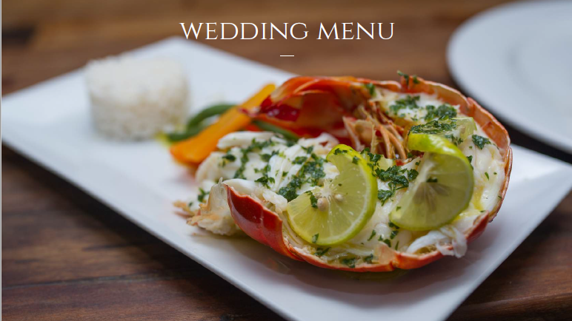

Slide 8
WEDDING MENU SELECTOR
STARTER
Pineapple Marinated Chicken Ballantine Wrapped
In Bacon, Caribbean Mayonnaise
Butter Roasted Lobster Cocktail, Iceberg Lettuce, Marie Rose Sauce
Chickpea Panisse, Roasted pepper and chickpea salsa ( v )
⁎
MAIN COURSE
Spiced Shrimp And Ribeye Steak, Parsley Potatoes,
Seasonal Sautéed Veg, Garlic Butter Sauce
Roast Loin Of Pork, Dauphinois Potatoes, Julienne
Of Seasonal Veg, Maple Balsamic Sauce
Roasted Red Pepper Linguine, Basil, Chilli Bread Crumbs ( v )
⁎
DESSERT
Passionfruit, Banana , Chocolate Flavours
Coconut Cheesecake, Cherry Puree
Pear Almond Tartlet, Red Wine Reduction ( v )
Please choose 1 starter, 1 main and 1 dessert for the entire party to enjoy.
Our Chef will always cater for any dietary requirements
WEDDING BUFFET MENU
Jerk Chicken salad garlic croutons
Tomato and Mozzarella Salad with Balsamic and Olive Oil Dressing
Marinated Roasted Vegetable Salad
⁎
Pork Baby ribs, Honeyed barbeque sauce
Thyme Roasted Chicken Breasts
Bequia Caught Grilled Fish
Penne Pasta, Roast eggplant and red peppers, Pesto dressing
⁎
Calypso Rice
Seasonal Vegetables
Roasted Garlic Potatoes
⁎
Selection of handmade desserts

Slide 9
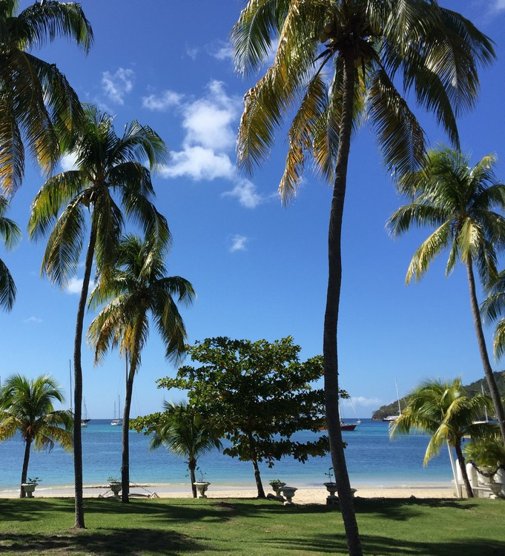
Conditions of the booking
Accommodation Rates are inclusive of 11% tax and 10% service charge.
The Government of Saint Vincent and the Grenadines has introduced a new
tax for visitors whereby visitors pay $3 USD (based on two persons sharing)
to help restore the islands after natural disasters This will be taken at the
hotel and paid on the visitor’s behalf.
To confirm and guarantee your date we will require a non refundable deposit
with remaining balance due 120 days prior to arrival. The hotel’s 120 day
cancellation policy is on all exclusive use contracts. If you decide to cancel
within the 120 days of the arrival date, you will be liable to the total cost.
Wedding requirements
Laws of St. Vincent and the Grenadines
• If divorced, a divorce absolute must be presented,
they have to present the divorce absolute
• If widowed, a death certificate/absolute to be presented
(If a copy is presented, please ensure document is certified)
• Bride and groom are required to be present in the country
at least one day before wedding application
• Valid passport for both parties must be presented
• Birth certificates obtained in St. Vincent and the Grenadines
only (certificates must be accompanied by a photo id).
Governor General Licenses fee EC$500.00 (application must be made at least
24 hours before) a certification is required for the form by a Justice of Peace.
Once the application is completed at the High Court Registry, it will then
proceed to the Attorney General’s Office, payment to be made at Treasury
EC$15.00 and stamp fees.
Disclaimer
Bride and groom must be married on the property of the Bequia Plantation Hotel
for offers made in packages to apply.

